Slide 1

CMP362/CMPN446: Image Processing and Computer Vision
Texture Analysis
Mayada Hadhoud
Computer Engineering Department
Cairo University

Slide 2
Agenda
What is Texture?
Uses for Texture Analysis
Texture Analysis Approaches
Structural Approach
Statistical Approach
Statistical Texture Measures
Edge Density and Directions
LBP Measure
GLCM
Laws’ Texture Energy Features

Slide 3
What is Texture?
a feature used to partition images into regions of interest and to classify those regions
Texture is a repeating pattern of local variations in image intensity
Image Texture gives us information about the spatial arrangement of color or intensities in an image or selected region of an image
cannot be defined for a point

Slide 4

What is Texture?
For example, an image has a 50% black and 50% white distribution of pixels.
Three different images with the same intensity distribution, but with different textures.

Slide 5
Texture
Texture consists of texture primitives or texture elements, sometimes called texels.
– Texture features are found in the tone and structure of a texture.
– Tone is based on pixel intensity properties in the texel, while structure represents the spatial relationship between texels.
Notes:
– Primitives in grass and dog fur are represented by several pixels and correspond to a stalk or a pile; cork is built from primitives that are comparable in size with pixels. It is difficult, however, to define primitives for the checkered textile or fabric, which can be defined by at least two hierarchical levels
A texture primitive(Texels) is a contiguous set of pixels with some tonal and/or regional property, and can be described by its average intensity, maximum or minimum intensity, size, shape, etc. The spatial relationship of primitives can be random, or they may be pairwise dependent, or some number of primitives can be mutually dependent.
Image texture is then described by the number and types of primitives and by their spatial relationship.
Texture can be described as fine, coarse, grained, smooth, etc.
If texels are small and tonal differences between texels are large a fine texture results. – If texels are large and consist of several pixels, a coarse texture results.
5

Slide 6
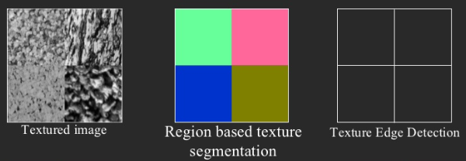
Uses for Texture Analysis
Segment an image into regions with the same texture.
Recognize or classify objects based on their texture .
Find edges in an image, i.e. where the texture changes .
”shape from texture”

Slide 7
Texture Analysis Approaches
Structural Approach
texture is a set of primitive texels in some regular or repeated relationship.
Statistical Approach
texture is a quantitative measure of the arrangement of intensities in a region.
This set of measurements is called a feature vector.

Slide 8
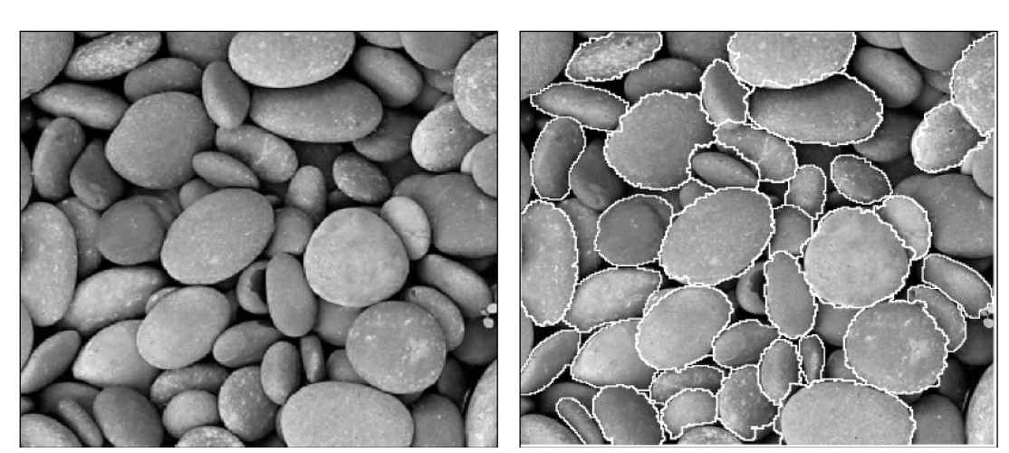
Structural Approach
A texture is a set of texture elements or texels occurring in some regular or repeated pattern

Slide 9
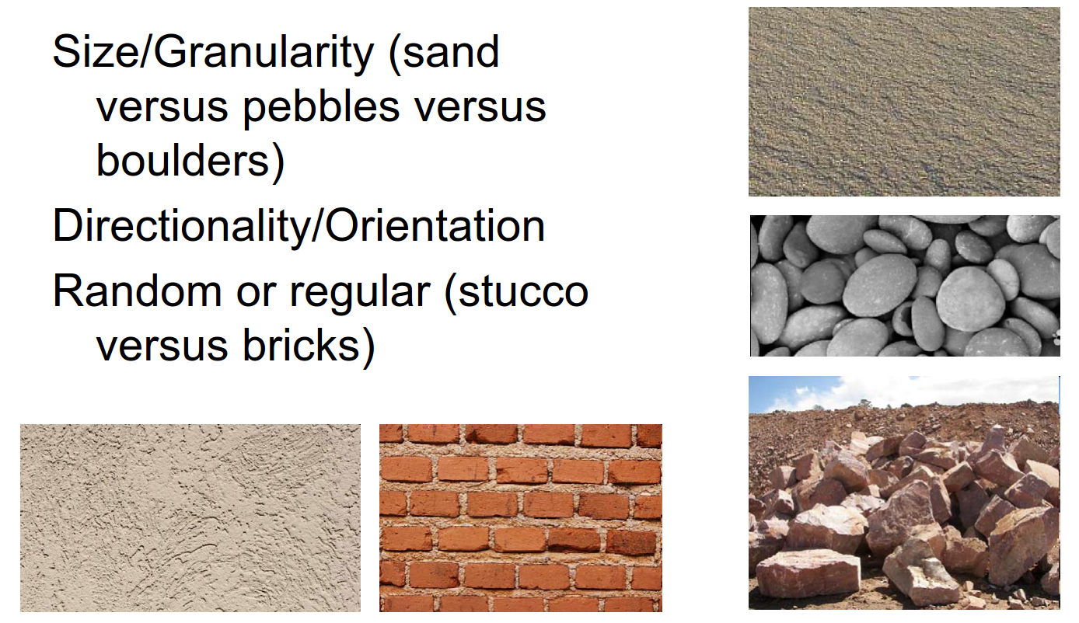
Structural Approach

Slide 10
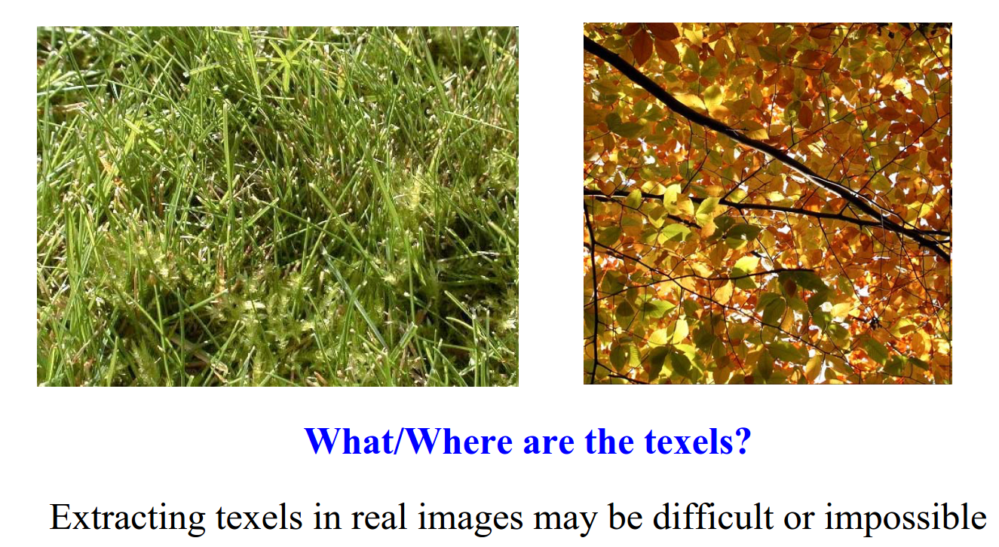
Problems with Structural Approach

Slide 11
Statistical Approach
Segmenting out texels is difficult or impossible in real images.
Numeric quantities or statistics that describe a texture can be computed from the gray tones (or colors) alone.
This approach is less intuitive, but is computationally efficient.
It can be used for both classification and segmentation.

Slide 12
Statistical Texture Measures
Edge Density and Direction
Use an edge detector as the first step in texture analysis.
The number of edge pixels in a fixed-size region tells us
how busy that region is.
The directions of the edges also help characterize the texture
Notes:
Reference https://courses.cs.washington.edu/courses/cse576/book/ch7.pdf
12

Slide 13
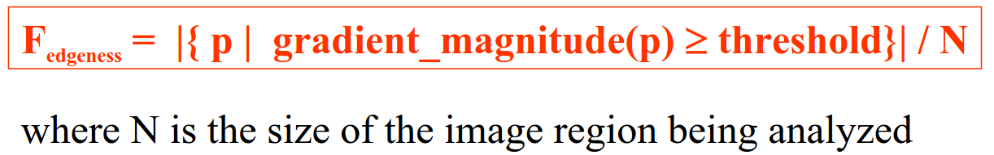
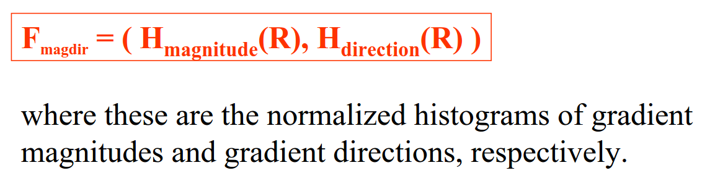
Statistical Texture Measures
Edge Density and Direction
Edgeness per unit area : Given pixels P in a region
Histogram of edge magnitude and directions in a region R
Notes:
Edgeness per unit area measures the busyness, but not the orientation of the texture.
13

Slide 14
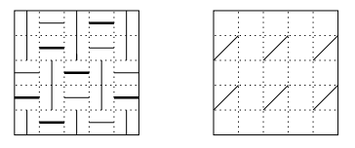
Statistical Texture Measures
Edge Density and Direction
Notes:
The image on the left is busier than the image on the right. It has an edge in every one of its 25 pixels, so its edgeness per unit area is 1.0. The image on the right has 6 edges out of its 25 pixels, so its edgeness per unit area is only 0.24.
14

Slide 15
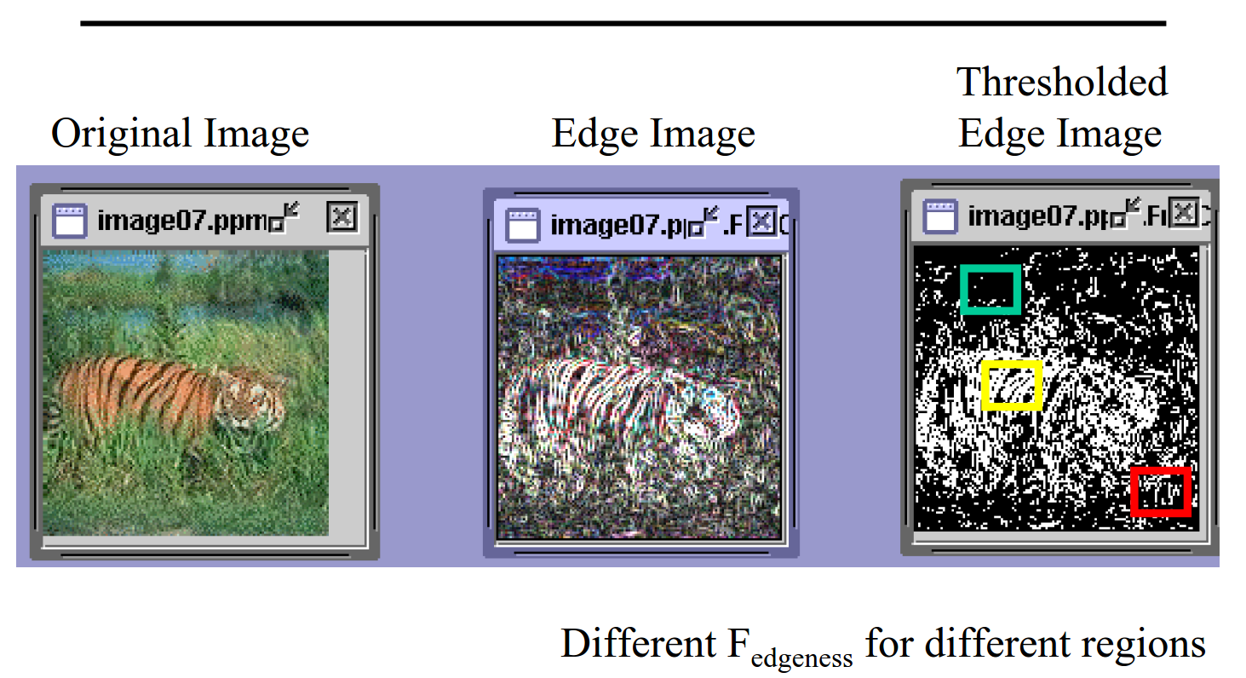

Slide 16
Statistical Texture Measures
Local Binary Pattern (LBP)
For each pixel p, create an 8-bit number b1 b2 b3 b4 b5 b6 b7 b8,
where bi = 0 if neighbor i has value less than or equal to p’s
value and 1 otherwise.
Represent the texture in the image (or a region) by the
histogram of these numbers.
1 2 3
100 101 103
40 50 80
50 60 90
4
5
8
1 1 1 1 1 1 0 0
7 6
Notes:
Two images or regions are compared by computing the L1 distance between their histograms as defined above.
16

Slide 17
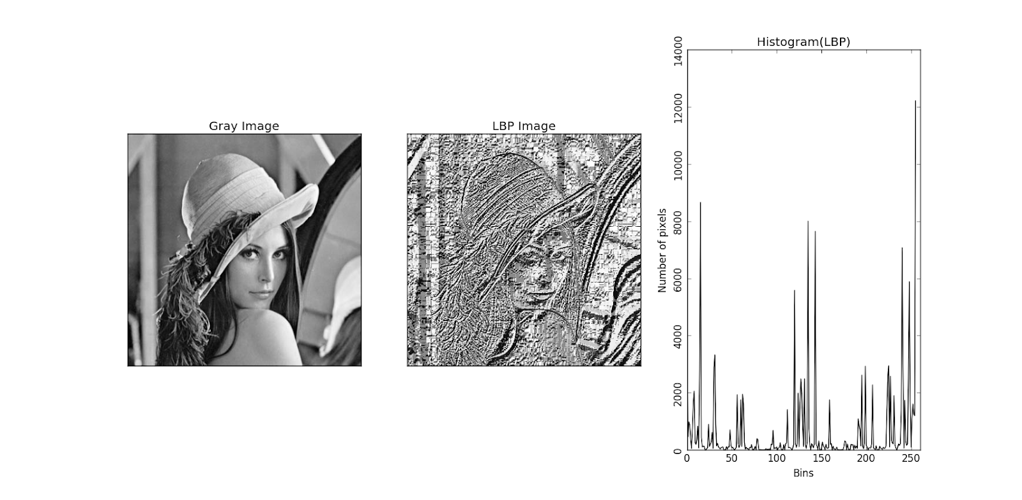
LBP Example

Slide 18
Statistical Texture Measures
GLCM (Gray Level Co-occurrence Matrix)Features
A co-occurrence matrix is a 2D array C in which
Both the rows and columns represent a set of possible
image values.
C (i,j) indicates how many times value i co-occurs with
value j in a particular spatial relationship d.
The spatial relationship is specified by a vector d = (dr,dc).
d

Slide 19
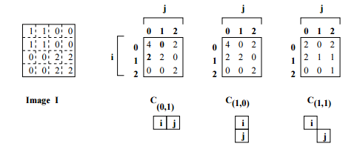
Co-occurrence Matrix Example

Slide 20
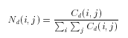
Co-occurrence Matrix Example
1
0 1 2
1 1 0 0
1 1 0 0
0 0 2 2
0 0 2 2
0 0 2 2
0 0 2 2
i
j
0
1
2
1 0 3
2 0 2
0 0 1
3
C_{d}
d = (3,1)
co-occurrence
matrix
gray-tone
image
From C_{d} we can compute N_{d}, the normalized co-occurrence matrix,
where each value is divided by the sum of all the values.
Notes:
16

Slide 21
Statistical Texture Measures
GLCM Features
Co-occurrence matrices capture properties of a texture, but they are not directly useful for further analysis, such as comparing two textures
numeric features are computed from the co-occurrence matrix that can be used to represent the texture more compactly.

Slide 22
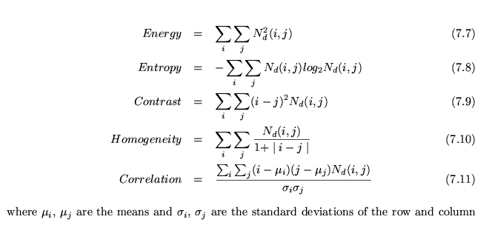
Statistical Texture Measures
GLCM Features
Notes:
1- Contrast: Contrast is a measure of intensity contrast between a pixel and its neighbor over the entire image. If the image is constant, contrast equal 0 while the biggest value can be obtained when the image is a random intensity image and that pixel intensity and neighbor intensity are very different
2- Energy: Energy is a measure of uniformity where is maximum when the image is constant
also called Uniformity . measures the textural uniformity that is pixel pair repetitions. It detects disorders in textures
3- Homogeneity: Homogeneity measures the spatial closeness of the distribution of the co-occurrence matrix. Homogeneity equal 0 when the distribution of the cooccurrence matrix is uniform and 1 when the distribution is only on the diagonal of the matrix
4- Entropy: Entropy measures the randomness of the elements of the co-occurrence matrix. Entropy is maximum when elements in the matrix are equal while is equal to 0 if all elements are different.
measures the disorder or complexity of an image.
The entropy is large when the image is not texturally uniform and many GLCM elements have very small values. Complex textures tend to have high entropy
22

Slide 23
0 | <- Measure -> | 1
Constant Image | Contrast measure of intensity contrast between a pixel and its neighbor over the entire image | Random intensity image
Random Image | Energy measures the textural uniformity , detects disorders in textures | Constant Image
All elements in the matrix are different. | Entropy measures the randomness of the elements of the co-occurrence matrix | Elements in the matrix are equal
Distribution of the co-occurrence matrix is uniform | Homogeneity measures the spatial closeness of the distribution of the co-occurrence matrix | The distribution is only on the diagonal of the matrix
Notes:
22

Slide 24
Windowing
• Algorithms for texture analysis are applied to an image in a series of windows of size w, each centered on a pixel (i,j).
• The value of the resulting statistical measure are assigned to the position (i,j) in the new pixel.

Slide 25
Laws’ Texture Energy Features
Signal-processing-based algorithms use texture filters
applied to the image to create filtered images from which
texture features are computed.
The Laws Algorithm
Filter the input image using texture filters.
Compute texture energy by summing the absolute
value of filtering results in local neighborhoods
around each pixel.
Combine features to achieve rotational invariance.
Notes:
22
Textures are made up of repeated local patterns, so: – Find the patterns
• Use filters that look like patterns (spots, bars, raw patches…)
• Consider magnitude of response

Slide 26
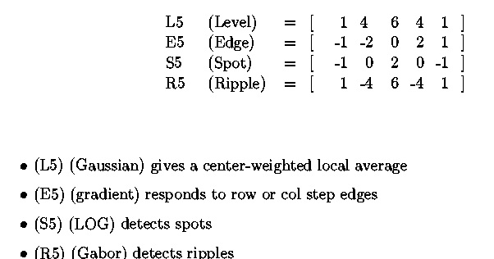
Law’s texture masks (1)
Notes:
22
The L5 vector gives a center-weighted local average.
The E5 vector detects edges,
the S5 vector detects spots, and
the R5 vector detects ripples.

Slide 27
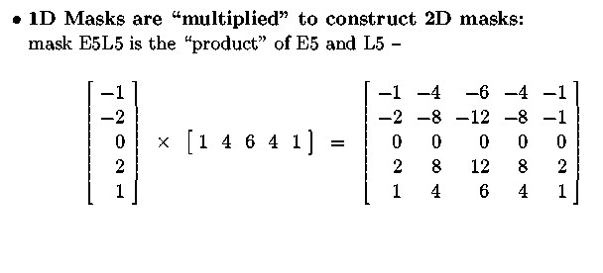
Law’s texture masks (2)
Creation of 2D Masks
E5
L5
E5L5
Notes:
<number>

Slide 28
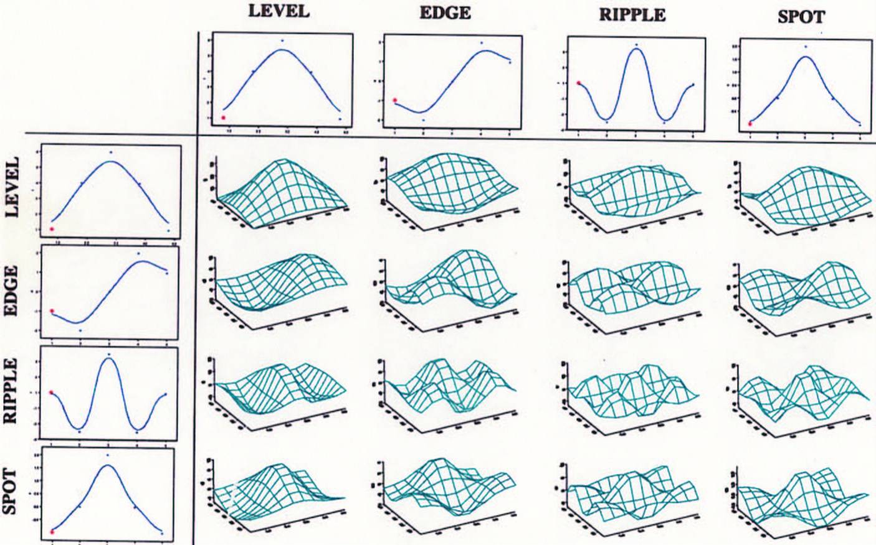
Laws Filters
Notes:
<number>

Slide 29
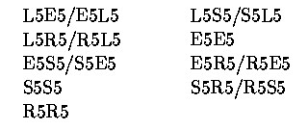
9D feature vector for pixel
Subtract mean neighborhood intensity from (center) pixel to remove effects of illumination
Apply 16 5x5 masks to get 16 filtered images F_{k} , k=1 to 16
Produce 16 texture energy maps using 15x15 windows
E_{k}[r,c] = ∑ |F_{k}[i,j]|
Replace each distinct pair with its average map
9 features (9 filtered images) defined as follows:
Notes:
<number>
Step 1: The first step in Laws' procedure is to remove effects of illumination by moving a small window around the image, and subtracting the local average from each pixel, to produce a preprocessed image, in which the average intensity of each neighborhood is near to zero.
In step 3 each pixel will be replaced by the average of the absolute values of its neighbors in a window 15x15. this will generate 16 different images describing the texture energy of the image
In step 4 : Once the sixteen energy maps are produced, certain symmetric pairs are combined to produce the nine nal maps, replacing each pair with its average. For example, E5L5 measures horizontal edge content, and L5E5 measures vertical edge content. The average of these two maps measures total edge content.

Slide 30
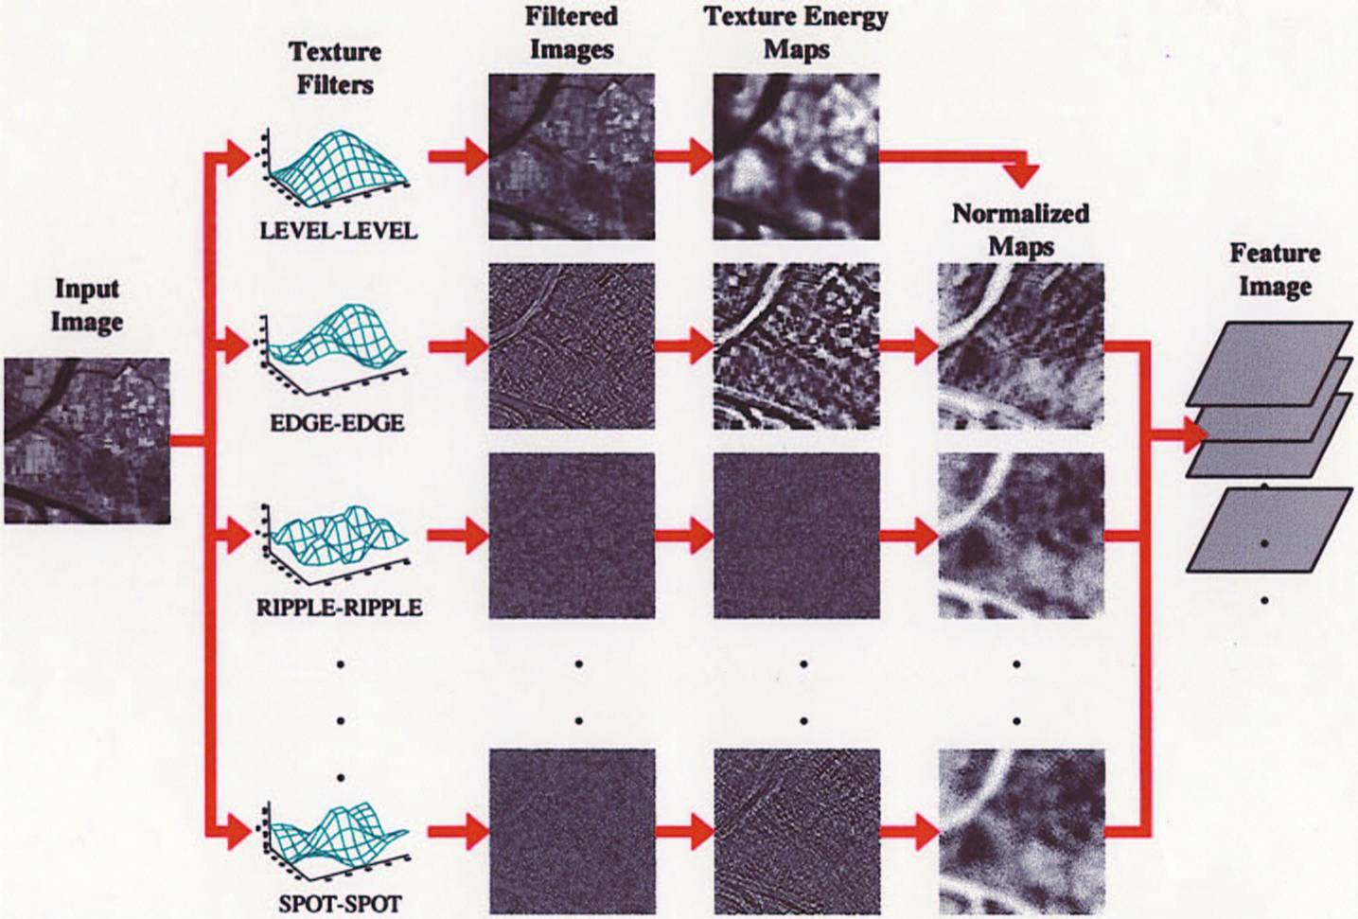
Laws Process
Notes:
<number>
Gabor filters are also texture filters

